Slide 1

INTRODUCTION

Slide 2
PL/SQL
PL/SQL is Oracle's procedural language extension to SQL, the non-procedural relational database language.
With PL/SQL, you can use SQL statements to manipulate ORACLE data and the flow of control statements to process the data. Moreover, you can declare constants and variables, define subprograms (procedures and functions), and trap runtime errors. Thus, PL/SQL combines the data manipulating power of SQL with the data processing power of procedural languages.

Slide 3
What is PL/SQL?
PL/SQL is a Procedural Language extension of Structured Query Language (SQL).
PL/SQL is an extension of Structured Query Language (SQL) that is used in Oracle. Unlike SQL, PL/SQL allows the programmer to write code in a procedural format.
PL/SQL (Procedural Language/Structured Query Language) program executes on Oracle database.
PL/SQL is specially designed for Database oriented activities. Oracle PL/SQL allows you to perform data manipulation operation those are safe and flexible.

Slide 4
PL/SQL
It combines the data manipulation power of SQL with the processing power of procedural language to create super powerful SQL queries
While PL/SQL is just like any other programming language, it has syntax and rules that determine how programming statements work together. It is important for you to realize that PL/SQL is not a stand-alone programming language.
PL/SQL is a part of the Oracle RDBMS, and it can reside in two environments, the client and the server.

Slide 5
PL/SQL
As a result, it is very easy to move PL/SQL modules between server-side and client-side applications.
When the PL/SQL engine is located on the server, the whole PL/SQL block is passed to the PL/SQL engine on the Oracle server.

Slide 6
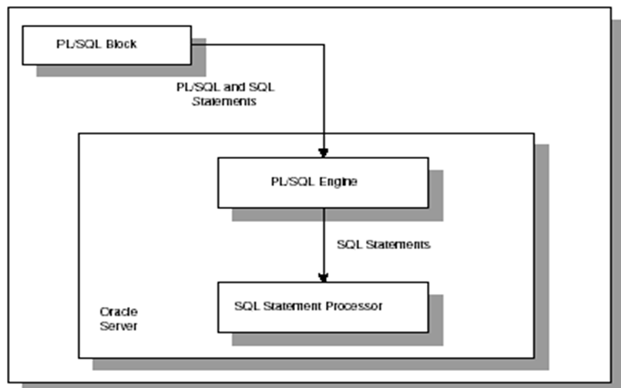
The PL/SQL engine processes the block according to the following Figure

Slide 7
Combines the flexibility of SQL (4GL) with the power and configurability of the procedural constructs of a 3GL.
Extends SQL by adding 3GL constructs such as:
  Variables and types (predefined and user defined)
  Control Structures (IF-THEN-ELSE, Loops)
  Procedures and functions
  Object types and methods
PL/SQL based on language constructs
  Block Structure
  Error Handling
  Variables and Types
  Conditionals
  Looping Constructs
  Cursors

Slide 8
PL/SQL
When the PL/SQL engine is located on the client, as it is in the Oracle Developer Tools, the PL/SQL processing is done on the client side.
All SQL statements that are embedded within the PL/SQL block are sent to the Oracle server for further processing. When PL/SQL block contains no SQL statement, the entire block is executed on the client side.

Slide 9
DIFFERENCE BETWEEN PL/SQL AND SQL
When a SQL statement is issued on the client computer, the request is made to the database on the server, and the result set is sent back to the client.
As a result, a single SQL statement causes two trips on the network. If multiple SELECT statements are issued, the network traffic increase significantly very fast. For example, four SELECT statements cause eight network trips.
If these statements are part of the PL/SQL block, they are sent to the server as a single unit. The SQL statements in this PL/SQL program are executed at the server and the result set is sent back as a single unit. There is still only one network trip made as is in case of a single SELECT statement.

Slide 10
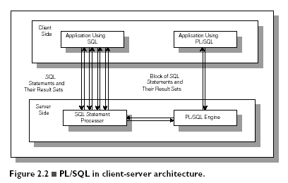
Comparison of SQL*PLUS and PL/SQL

Slide 11
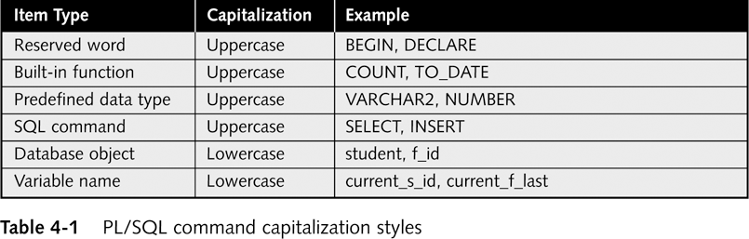
Fundamentals of PL/SQL
Full-featured programming language
Interpreted language
Execute using Oracle 10g utilities
  SQL*Plus
  Forms Builder
Combines SQL queries with procedural commands
Reserved words

Slide 12

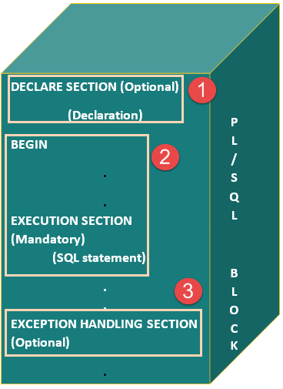

Slide 13
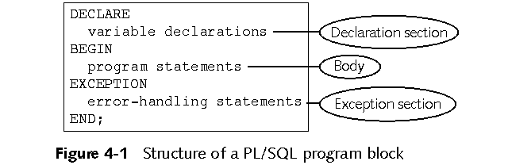
PL/SQL Program Blocks
Comments:
  Not executed by interpreter
  Enclosed between /* and */
  On one line beginning with --

Slide 14
PL/SQL BLOCKS
PL/SQL blocks can be divided into two groups:
  Named
  Anonymous.
Named blocks are used when creating subroutines. These subroutines, are procedures, functions, and packages.
The subroutines can be stored in the database and referenced by their names later on.
In addition, subroutines can be defined within the anonymous PL/SQL block.
Anonymous PL/SQL blocks do not have names. As a result,they cannot be stored in the database and referenced later.

Slide 15
PL/SQL BLOCK STRUCTURE
PL/SQL blocks contain three sections
  Declare section
  Executable section and
  Exception-handling section.
The executable section is the only mandatory section of the block.
Both the declaration and exception-handling sections are optional.

Slide 16
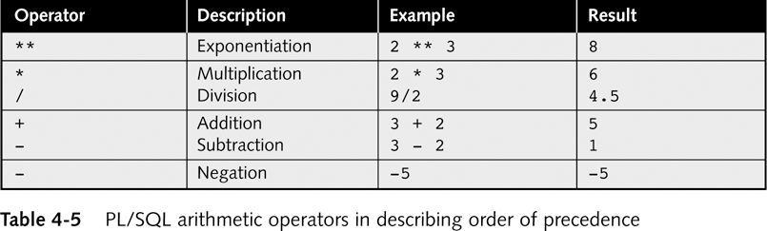
PL/SQL Arithmetic Operators in describing Order of Precedence
Parentheses are used to force PL/SQL interpreter to evaluate operations in a certain order
total_hours_worked - 40 * over_time_rate
(total_hours_worked – 40) * over_time_rate

Slide 17
Assignment Statements
DECLARE
variable1 NUMBER := 10;
variable2 NUMBER := 0;
BEGIN
variable2 := variable1 +1;
END;
Assigns value to variable
Operator: :=
Syntax: variable_name := value;
String literal within single quotation mark
Examples:
  current_s_first_name := ‘Gautam’;
  current_student_ID NUMBER := 100;
Result of adding a value to a NULL value is another NULL value
DEFAULT keyword can be used instead of assignment operator
Q: What is the final value of variable2?

Slide 18
Displaying PL/SQL Program Output in SQL*Plus
PL/SQL output buffer
  Memory area on database server
  Stores program’s output values before they are displayed to user
  Default buffer size is 2000 bytes
  Should increase size if you want to display more than a few lines in SQL Plus to avoid buffer overflow error
  Syntax: SET SERVEROUTPUT ON SIZE buffer_size
  Example: SET SERVEROUTPUT ON SIZE 4000

Slide 19
Displaying PL/SQL Program Output in SQL*Plus
DBMS_OUTPUT
  is an Oracle built-in package
  Consists of a set of programs for processing output
PUT_LINE is the DBMS_OUTPUT procedure for displaying output
  Syntax: DBMS_OUTPUT.PUT_LINE('display_text');
  Example: DBMS_OUTPUT.PUT_LINE(current_s_first);
  Displays maximum of 255 characters of text data
  If try to display more than 255 characters, error occurs

Slide 20
Writing a PL/SQL Program
Write PL/SQL program in Notepad or another text editor
  Indenting commands within each section is a good programming practice.
  Copy and paste program commands from text editor into SQL*Plus
Press Enter after last program command
Type front slash ( / )
Then press Enter again

Slide 21
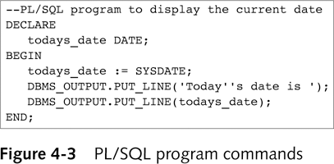
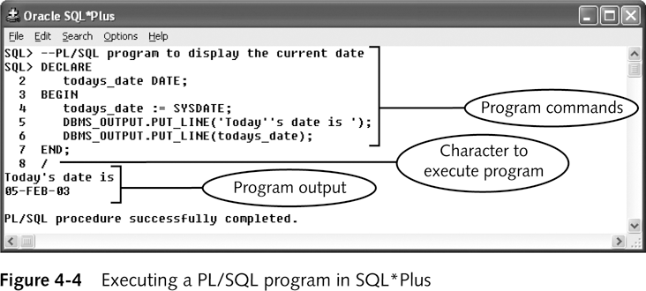
PL/SQL Program Commands

Slide 22
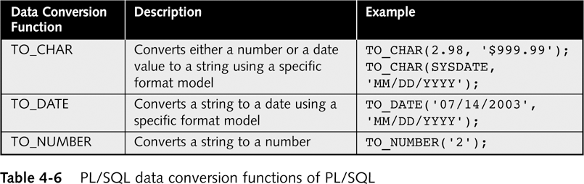
PL/SQL Data Conversion Functions
WHERE O_DATE = TO_DATE (‘29/05/2006’, ‘DD/MM/YYYY’)
Implicit data conversions
  Interpreter automatically converts value from one data type to another
  If PL/SQL interpreter unable to implicitly convert value error occurs
Explicit data conversions
  Convert variables to different data types
  Using data conversion functions
WHERE O_DATE = ‘29/05/2006’

Slide 23
Manipulating Character Strings
Concatenating
  Joining two separate strings
  Operator: || (i.e. double bar)
  Syntax: new_string := string1 || string2;
  Example: s_fullname := s_first || s_last;
Parse
  Separate single string consisting of two data items separated by commas or spaces
  s_fullname := s_first ||‘ ’|| s_last;
Variable | Data type | Value
Bldg_code | VARCHAR2 | LH
Room_num | VARCHAR2 | 101
Room_capacity | NUMBER | 150
room_message := bldg_code || ‘ Room ’ || room_num || ‘ has ’ || TO_CHAR(room_capacity) || ‘seats.’;
Question: Write down the value of room_message after the above Assignment statement is executed.

Slide 24
Debugging PL/SQL Programs
Syntax error
  Occurs when command does not follow guidelines of programming language
  Generate compiler or interpreter error messages
Logic error
  Does not stop program from running
  Results in incorrect result

Slide 25
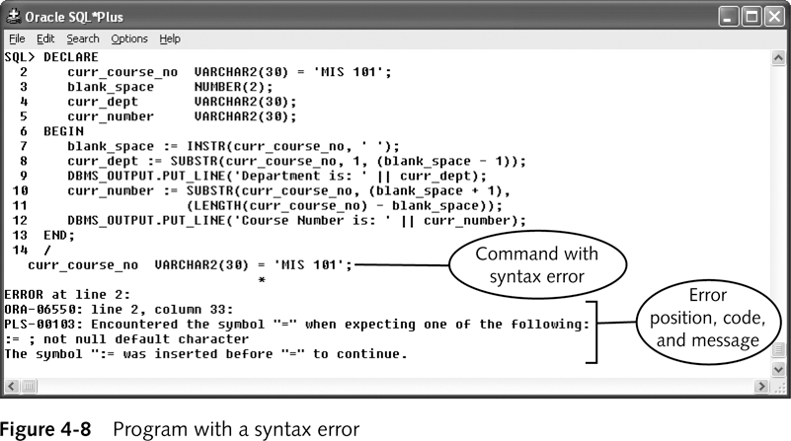
Program with a Syntax Error

Slide 26
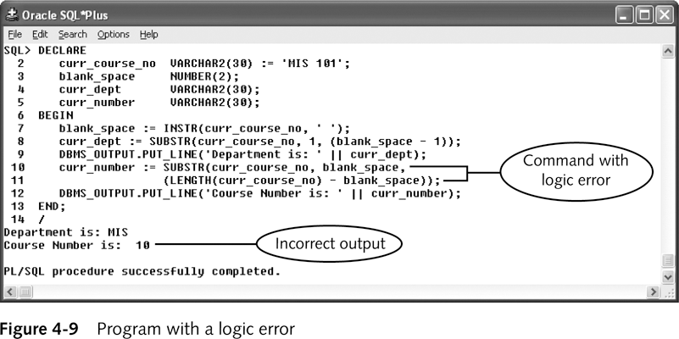
Program with a Logic Error
Which of the following is the source of the error?
  LENGTH(curr_course_no) – blank_space));
  SUBSTR(curr_course_no, blank_space,

Slide 27
PL/SQL BLOCK STRUCTURE
PL/SQL block has the following structure:
  DECLARE
  Declaration statements
  BEGIN
  Executable statements
  EXCETION
  Exception-handling statements
  END ;

Slide 28
DECLARATION SECTION
The declaration section is the first section of the PL/SQL block.
It contains definitions of PL/SQL identifiers such as variables, constants, cursors and so on.
Example
  DECLARE
  v_first_name VARCHAR2(35) ;
  v_last_name VARCHAR2(35) ;
  v_counter NUMBER := 0 ;

Slide 29
EXECUTABLE SECTION
The executable section is the next section of the PL/SQL block.
This section contains executable statements that allow you to manipulate the variables that have been declared in the declaration section.
  BEGIN
  SELECT first_name, last_name
  INTO v_first_name, v_last_name
  FROM student
  WHERE student_id = 123 ;
  DBMS_OUTPUT.PUT_LINE
  (‘Student name :’ || v_first_name ||‘ ’|| v_last_name);
  END;

Slide 30
EXCEPTION-HANDLING SECTION
The exception-handling section is the last section of the PL/SQL block.
This section contains statements that are executed when a runtime error occurs within a block.
Runtime errors occur while the program is running and cannot be detected by the PL/SQL compiler.
    EXCEPTION
    WHEN NO_DATA_FOUND THEN
    DBMS_OUTPUT.PUT_LINE
    (‘ There is no student with student id 123 ’);
    END;

Slide 31
HOW PL/SQL GETS EXECUTED
Every time an anonymous block is executed, the code is sent to the PL/SQL engine on the server where it is compiled.
The named PL/SQL block is compiled only at the time of its creation, or if it has been changed.
The compilation process includes syntax checking, binding and p-code generation.
Syntax checking involves checking PL/SQL code for syntax or compilation errors.
Once the programmer corrects syntax errors, the compiler can assign a storage address to program variables that are used to hold data for Oracle. This process is called Binding.

Slide 32
HOW PL/SQL GETS EXECUTED
After binding, p-code is generated for the PL/SQL block.
P-code is a list of instructions to the PL/SQL engine.
For named blocks, p-code is stored in the database, and it is used the next time the program is executed.
Once the process of compilation has completed successfully, the status for a named PL/SQL block is set to VALID, and also stored in the database.
If the compilation process was not successful, the status for a named PL/SQL block is set to INVALID.

Slide 33
PL/SQL IN SQL*PLUS
SQL*Plus is an interactive tool that allows you to type SQL or PL/SQL statements at the command prompt.
These statements are then sent to the database. Once they are processed, the results are sent back from the database and displayed on the screen.
There are some differences between entering SQL and PL/SQL statements.

Slide 34
SQL EXAMPLE
SELECT first_name, last_name
FROM student
WHERE student_id = 123;
The semicolon terminates this SELECT statement. Therefore, as soon as you type semicolon and hit the ENTER key, the result set is displayed to you.

Slide 35
PL/SQL EXAMPLE
DECLARE
v_first_name VARCHAR2(35);
v_last_name VARCHAR2(35);
BEGIN
SELECT first_name, last_name
INTO v_first_name, v_last_name
FROM student
WHERE student_id = 123;
DBMS_OUTPUT.PUT_LINE
('Student name: '||v_first_name||' '||v_last_name);
EXCEPTION
WHEN NO_DATA_FOUND THEN
DBMS_OUTPUT.PUT_LINE
('There is no student with student id 123');
END;
.
/

Slide 36
PL/SQL EXAMPLE
There are two additional lines at the end of the block containing “.” and “/”. The “.” marks the end of the PL/SQL block and is optional.
The “/” executes the PL/SQL block and is required.
When SQL*Plus reads SQL statement, it knows that the semicolon marks the end of the statement. Therefore, the statement is complete and can be sent to the database.
When SQL*Plus reads a PL/SQL block, a semicolon
marks the end of the individual statement within the block. In other words, it is not a block terminator.

Slide 37
PL/SQL EXAMPLE
Therefore, SQL*Plus needs to know when the block has ended. As you have seen in the example, it can be done with period and forward slash.
.
/

Slide 38
EXECUTING PL/SQL
PL/SQL can be executed directly in SQL*Plus.
A PL/SQL program is normally saved with an .sql extension.
To execute an anonymous PL/SQL program,
simply type the following command at the SQL prompt:
SQL> @DisplayAge

Slide 39
GENERATING OUTPUT
Like other programming languages, PL/SQL provides a procedure (i.e. PUT_LINE) to allow the user to display the output on the screen. For a user to able to view a result on the screen, two steps are required.
First, before executing any PL/SQL program, type the following command at the SQL prompt
(Note: you need to type in this command only once for every SQL*PLUS session):
SQL> SET SERVEROUTPUT ON;
or put the command at the beginning of the program, right before the declaration section.

Slide 40
GENERATING OUTPUT
Second, use DBMS_OUTPUT.PUT_LINE in your executable section to display any message you want to the screen.
Syntax for displaying a message:
DBMS_OUTPUT.PUT_LINE(<string>);
in which PUT_LINE is the procedure to generate the output on the screen, and DBMS_OUTPUT is the package to which the PUT_LINE belongs.
DBMS_OUTPUT_PUT_LINE(‘My age is ‘ || num_age);

Slide 41
SUBSTITUTION VARIABLES
SQL*Plus allows a PL/SQL block to receive input information with the help of substitution variables.
Substitution variables cannot be used to output the values because no memory is allocated for them.
SQL*Plus will substitute a variable before the PL/SQL block is sent to the database.
Substitution variables are usually prefixed by the ampersand(&) character or double ampersand (&&) character.

Slide 42
EXAMPLE
DECLARE
v_student_id NUMBER := &sv_student_id;
v_first_name VARCHAR2(35);
v_last_name VARCHAR2(35);
BEGIN
SELECT first_name, last_name
INTO v_first_name, v_last_name
FROM student
WHERE student_id = v_student_id;
DBMS_OUTPUT.PUT_LINE
('Student name: '||v_first_name||' '||v_last_name);
EXCEPTION
WHEN NO_DATA_FOUND THEN
DBMS_OUTPUT.PUT_LINE('There is no such student');
END;

Slide 43
EXAMPLE
When this example is executed, the user is asked to provide a value for the student ID.
The example shown above uses a single ampersand for the substitution variable.
When a single ampersand is used throughout the PL/SQL block, the user is asked to provide a value for each occurrence of the substitution variable.

Slide 44
EXAMPLE
BEGIN
DBMS_OUTPUT.PUT_LINE('Today is ‘||’&sv_day');
DBMS_OUTPUT.PUT_LINE('Tomorrow will be ‘||’ &sv_day');
END;
This example produces the following output:
Enter value for sv_day: Monday
old 2: DBMS_OUTPUT.PUT_LINE('Today is ‘||’ &sv_day');
new 2: DBMS_OUTPUT.PUT_LINE('Today is ‘||’ Monday');
Enter value for sv_day: Tuesday
old 3: DBMS_OUTPUT.PUT_LINE('Tomorrow will be ‘||’ &sv_day');
new 3: DBMS_OUTPUT.PUT_LINE('Tomorrow will be ‘||’ Tuesday');
Today is Monday
Tomorrow will be Tuesday
PL/SQL procedure successfully completed.

Slide 45
EXAMPLE
When a substitution variable is used in the script, the output produced by the program contains the statements that show how the substitution was done.
If you do not want to see these lines displayed in the output produced by the script, use the SET command option before you run the script as shown below:
SET VERIFY OFF;

Slide 46
EXAMPLE
Then, the output changes as shown below:
  Enter value for sv_day: Monday
  Enter value for sv_day: Tuesday
  Today is Monday
  Tomorrow will be Tuesday
  PL/SQL procedure successfully completed.
The substitution variable sv_day appears twice in this PL/SQL block. As a result, when this example is run, the user is asked twice to provide the value for the same variable.

Slide 47
EXAMPLE
BEGIN
DBMS_OUTPUT.PUT_LINE('Today is '||'&&sv_day');
DBMS_OUTPUT.PUT_LINE('Tomorrow will be ‘||’ &sv_day');
END;
In this example, substitution variable sv_day is prefixed by double ampersand in the first DBMS_OUTPUT.PUT_LINE statement.
As a result, this version of the example produces different output.

Slide 48
OUTPUT
    Enter value for sv_day: Monday
    old 2: DBMS_OUTPUT.PUT_LINE('Today is ‘||’ &&sv_day');
    new 2: DBMS_OUTPUT.PUT_LINE('Today is ‘||’ Monday');
    old 3: DBMS_OUTPUT.PUT_LINE('Tomorrow will be ‘||’ &sv_day');
    new 3: DBMS_OUTPUT.PUT_LINE('Tomorrow will be ‘||’ Monday');
    Today is Monday
    Tomorrow will be Monday
    PL/SQL procedure successfully completed.
  It is clear that the user is asked only once to provide the value for the substitution variable sv_day.
  As a result, both DBMS_OUTPUT.PUT_LINE statements use the value of Monday entered previously by the user.

Slide 49
Substitution Variables
Ampersand(&) character and double ampersand (&&) characters are the default characters that denote substitution variables.
There is a special SET command option available in SQL*Plus that allows to change the default character (&) to any other character or disable the substitution variable feature.
This SET command has the following syntax:
    SET DEFINE character
    or
    SET DEFINE ON
    or
    SET DEFINE OFF

Slide 50
Substitution Variables
The first set command option changes the prefix of the substitution variable from an ampersand to another character. This character cannot be alphanumeric or white space.
The second (ON option) and third (OFF option) control whether SQL*Plus will look for substitution variables or not.
In addition, ON option changes the value of the character back to the ampersand.

Slide 51


Slide 52
PL/SQL Loop : Basic Loop, FOR Loop, WHILE Loop
PL/SQL Loop Basic Loop, FOR Loop, WHILE Loop repeat a number of block statements in your PL/SQL program. Loop use when we have a block of statements for required to repeatedly certain number of times. PL/SQL loop statements 3 different forms:
1.Basic LOOP
2.WHILE LOOP
3.FOR LOOP
Oracle recommended to write a label when use loop statement. It's benefit to improve readability. label is not compulsory for execute loop. compiler does not check to label defined or not.
Define label before LOOP keyword and after END LOOP keyword.

Slide 53
Basic LOOP
Basic LOOP syntax:
[ label_name ] LOOP
statement(s);
END LOOP [ label_name ];
Example:
DECLARE
no NUMBER := 5;
BEGIN
LOOP
DBMS_OUTPUT.PUT_LINE ('Inside value: no = ' || no);
no := no -1;
IF no = 0 THEN EXIT;
END IF;
END LOOP;
DBMS_OUTPUT.PUT_LINE('Outside loop end');
END;
/

Slide 54
WHILE LOOP
WHILE LOOP write in following syntax format:
[ label_name ] WHILE condition LOOP
statement(s);
END LOOP [ label_name ];
EXAMPLE:
DECLARE
no NUMBER := 0;
BEGIN
WHILE no < 10 LOOP
no := no + 1;
END LOOP;
DBMS_OUTPUT.PUT_LINE('Sum :' || sum);
END;
/

Slide 55
FOR LOOP
FOR LOOP write in following syntax format:
[ label_name ] FOR current_value IN [ REVERSE ] lower_value..upper_value LOOP
statement(s);
END LOOP [ label_name ];123
Example Code:
BEGIN
FOR no IN 1 .. 5 LOOP
DBMS_OUTPUT.PUT_LINE('Iteration : ' || no);
END LOOP;
END;

Slide 56
REVERSE FOR Loop
Optional REVERSE keyword introduce to iteration is proceed from upper_value to lower_value range.
Example Code :
BEGIN
FOR no IN REVERSE 5 .. 1 LOOP
DBMS_OUTPUT.PUT_LINE('Iteration : ' || no);
END LOOP;
END;
/

Slide 57
EXIT Statement
EXIT statement unconditionally exit the current loop iteration and transfer control to end of current loop. EXIT statement writing syntax,
DECLARE
no NUMBER := 5;
BEGIN
LOOP
DBMS_OUTPUT.PUT_LINE ('Inside value: no = ' || no);
no := no -1;
IF no = 0 THEN
EXIT;
END IF;
END LOOP;
DBMS_OUTPUT.PUT_LINE('Outside loop end');
-- After EXIT control transfer this statement
END;
/

Slide 58
EXIT WHEN Statement
EXIT WHEN statement unconditionally exit the current loop iteration when WHEN clause condition true.
DECLARE
i number;
BEGIN
LOOP
dbms_output.put_line('Hello');
i:=i+1;
EXIT WHEN i>5;
END LOOP;
END;
/

Slide 59
CONTINUE Statement
CONTINUE Statement unconditionally skip the current loop iteration and next iteration iterate as normal, only skip matched condition.
Syntax:
IF condition THEN
CONTINUE;
END IF;
Example Code:
DECLARE
no NUMBER := 0;
BEGIN
FOR no IN 1 .. 5 LOOP
IF i = 4 THEN
CONTINUE;
END IF;
DBMS_OUTPUT.PUT_LINE('Iteration : ' || no);
END LOOP;
END;
/

Slide 60
CONTINUE WHEN Statement
CONTINUE WHEN Statement unconditionally skip the current loop iteration when WHEN clauses condition true,
Syntax:
CONTINUE WHEN condition;
statement(s);
Example Code:
DECLARE
no NUMBER := 0;
BEGIN
FOR no IN 1 .. 5 LOOP
DBMS_OUTPUT.PUT_LINE('Iteration : ' || no);
CONTINUE WHEN no = 4
DBMS_OUTPUT.PUT_LINE('CONTINUE WHEN EXECUTE Iteration : ' || no);
END LOOP;
END;
/

Slide 61
GOTO Statement
GOTO statement unconditionally transfer program control. GOTO statement writing syntax,
Syntax
GOTO code_name
-----------
-----------
<<code_name>>
-----------
Example:
BEGIN
FOR i IN 1..5 LOOP
dbms_output.put_line(i);
IF i=4 THEN
GOTO label1;
END IF;
END LOOP;
<<label1>>
DBMS_OUTPUT.PUT_LINE(‘khela sesh!!');
END;
/

Slide 62
PL/SQL Case Statement
PL/SQL CASE statement comparing one by one sequencing conditions. CASE statement attempt to match expression that is specified in one or more WHEN condition.
CASE statement are following two forms:
1.Simple CASE Statement
2.Searched CASE Statement
Simple CASE Statement
PL/SQL simple CASE statement evaluates selector and attempt to match one or more WHEN condition.
CASE selector
WHEN value-1
THEN statement-1;
WHEN value-2
THEN statement-2;
ELSE
statement-3;
END CASE

Slide 63
DECLARE
a number := 7;
BEGIN
CASE a
WHEN 1 THEN
DBMS_OUTPUT.PUT_LINE('value 1');
WHEN 2 THEN
DBMS_OUTPUT.PUT_LINE('value 2');
WHEN 3 THEN
DBMS_OUTPUT.PUT_LINE('value 3'); ELSE
DBMS_OUTPUT.PUT_LINE('no matching CASE found');
END CASE;
END;
/

Slide 64
Searched CASE Statement
PL/SQL searched CASE statement has not selector and attempt to match one or more WHEN clauses condition.
Syntax
CASE
WHEN condition-1 THEN
statement-1;
WHEN condition-2 THEN
statement-2;
ELSE
statement-3;
END CASE;

Slide 65
DECLARE
a number := 3;
BEGIN
CASE
WHEN a = 1 THEN
DBMS_OUTPUT.PUT_LINE('value 1');
WHEN a = 2 THEN
DBMS_OUTPUT.PUT_LINE('value 2');
WHEN a = 3 THEN
DBMS_OUTPUT.PUT_LINE('value 3');
ELSE
DBMS_OUTPUT.PUT_LINE('no matching CASE found');
END CASE;
END;
/

